Slide 1
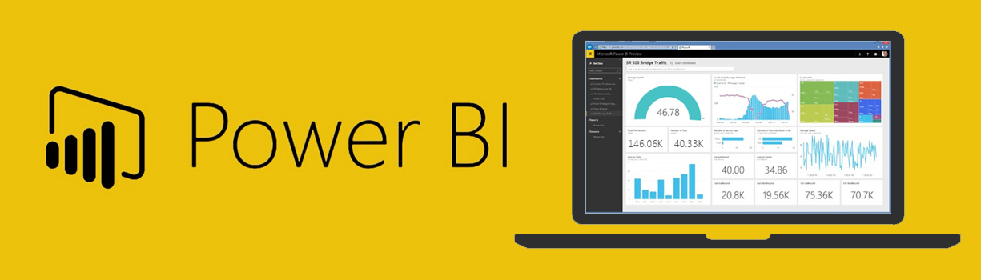
Data Cleaning with Power BI and Python Rónai Bertalan BI DEVELOPER
Notes:
https://www.linkedin.com/in/ronaibertalan/
Hungarian Python meetup group https://www.meetup.com/budapest-py/events

Slide 2
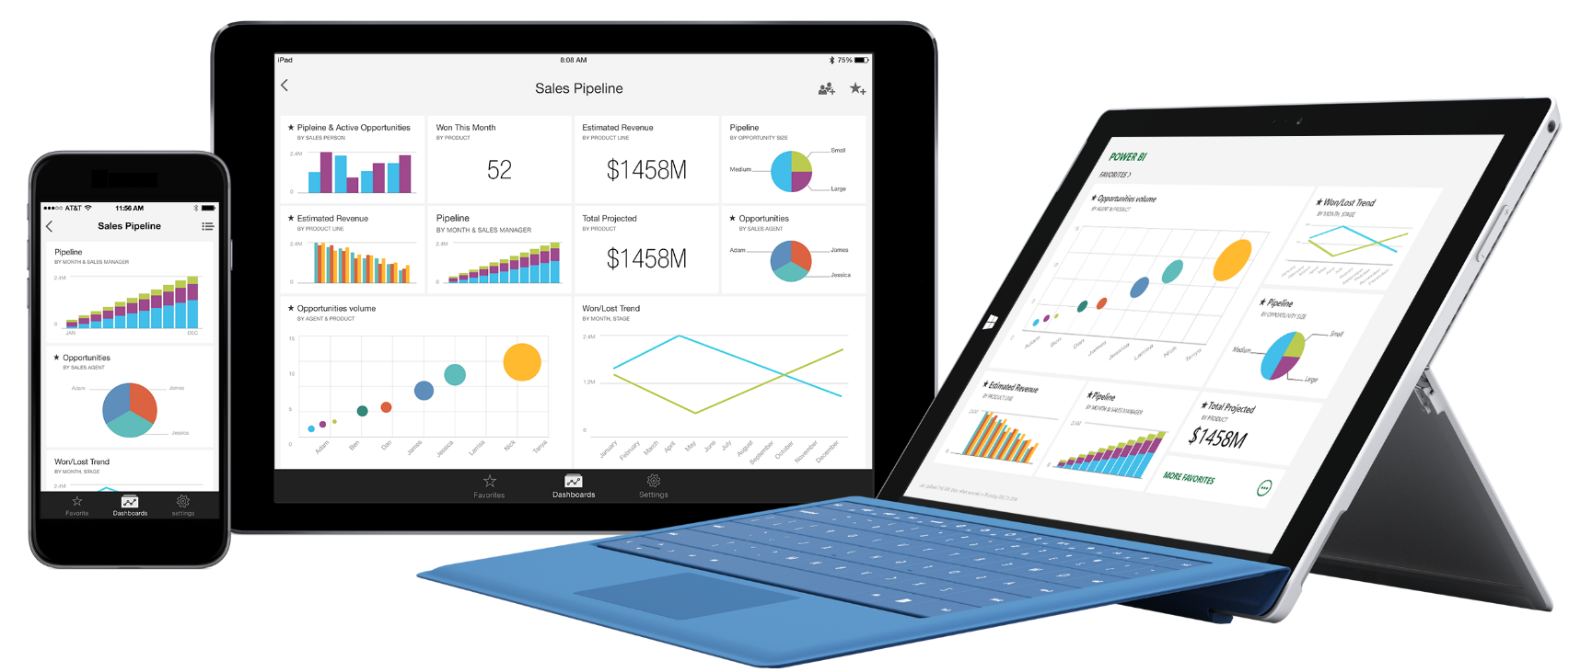
Power BI products
Power BI (Cloud) Service
Power BI Desktop (free)
Power BI Report Server
Power BI Mobile (Windows Phone/Android/iPhone)
Power BI Embedded

Slide 3
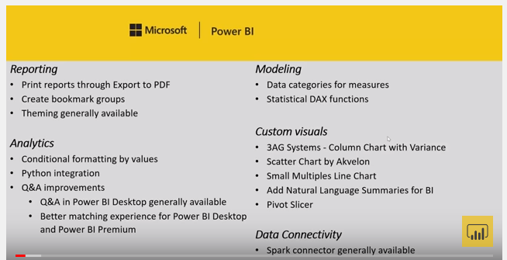
In the 2018 August release Microsoft added Python compatibility
2018 August Feature Summary
Python Episode 1 – A New hope
Notes:
https://powerbi.microsoft.com/en-us/blog/power-bi-desktop-august-2018-feature-summary/
https://powerbi.microsoft.com/en-us/blog/pythonblogepisode1/

Slide 4
In the 2018 August release Microsoft added Python compatibility
Python Developers can connect to the data source in Python, transform the data in pandas and use the Python visuals.
BI Developers should only use Python code when they can’t solve the task by the other languages or features.
Using the GUI of Power BI you can save time coding in Python and add interactivity to reports.
Users need to have Python installed to see Python visuals and to refresh data if Python was used in the query editor.
plt.savefig() as alternate solution.
Notes:
I think the best way to install Python is to use Anaconda. My preferable install path is c:\Anaconda. - This note is for PBI Devs of course.
But you need to have Python installed for Power BI, Anaconda is not enough.

Slide 5
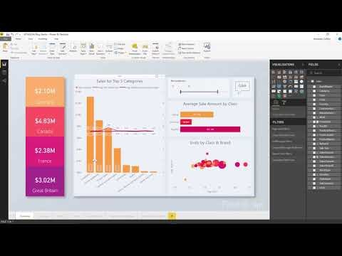
A Power BI Desktop download
New version in every month
Power BI App from Windows Store (updates automatically)
What's new in the latest Power BI Desktop update?
Previous monthly updates to Power BI Desktop

Slide 6




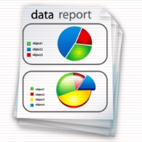




Power BI development steps
Get Data
Data format
Column selection
Filtering, ordering
Row and column manipulation
Modeling
Relationships
Calculated columns
Measures
Hierarchies
Reports and Dashboards
Publish
Check visuals and business values!
or
Notes:
PBI is capable of doing complex ETL tasks.

Slide 7
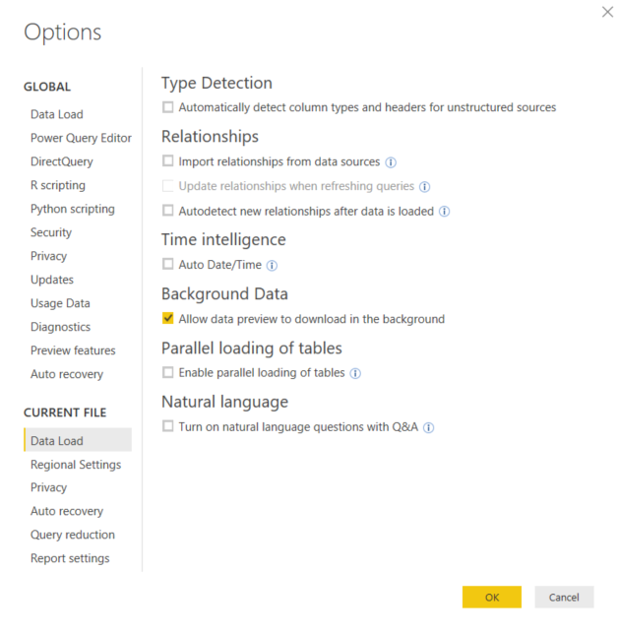
Power BI Desktop Configuration
Global and locale settings
Notes:
This options page is the most important. I personally like to manage the relationships manually and prefer not to use Auto Date/Time.
What if you have 2 columns with the same name? Yes, it would assume, they are keys and create a relationship between them.

Slide 8
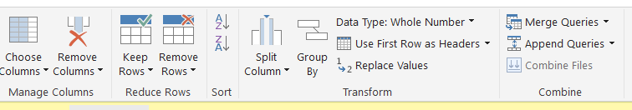
Power Query / Query editor
A Power BI programming languages
Connect to dozens of data source types!
Interface to manage ETL (Extract Transform Load) tasks, query editor in Power BI is mostly the same as power query in Microsoft Excel.
Using the graphical interface, we are writing code in a language called M. We can see the code in the advanceed query editor and in the formula bar.
There are many more functions in M than you can use by using the GUI.

Slide 9
Power BI data cleaning demo
Notes:
Memo to start the AdventureWorks demo – will not be publicly shared
https://pypi.org/project/iexfinance/

